Slide 1
Make.com
Part 1
Ali Daryabak
Ali Daryabak
ECRM Manager
Marketing Automation Expert

Slide 2
Make.com Fundamentals
01
02
03
What is Make.com
Make.com Fundamentals
Login To Make.com
Ali Daryabak
ECRM Manager
Marketing Automation Expert

Slide 3
What is Make.com
Ali Daryabak
ECRM Manager
Marketing Automation Expert

Slide 4
Make.com is a tool that allows you to automate tasks and processes between different apps and services. You can connect apps like Google Sheets, Slack, Gmail, or even databases, without writing any code. These connections are called scenarios.

Slide 6
Make.com Fundamentals
Ali Daryabak
ECRM Manager
Marketing Automation Expert

Slide 7
Key Terms You Should Know
System Events
01
Scenario: An automated workflow that links two or more apps/services
02
Modules: Each step in a scenario, like sending an email or updating a spreadsheet
03
Trigger: The starting point of the workflow (e.g., "when a new email arrives")
04
Actions: What happens next (e.g., "add the email content to a Google Sheet")

Slide 8
Login to Make.com and Make Scenario
Ali Daryabak
ECRM Manager
Marketing Automation Expert

Slide 9
Here’s a simple guide to building your first automation on Make.com:
Step1: Create a Scenario
Go to Make.com and sign up/login
Click "Create a New Scenario."
Step2: Select a Trigger
Choose the app that will start the workflow.
For example:
Trigger: “New row added to Google Sheets.”

Slide 10
Step 3: Add Modules
Add an action or another app to connect. Examples:
Module 1: Send the data to Slack as a message.
Module 2: Update another app, like Trello or Airtable.
Step 4: Configure and Map Data
Configure each module by selecting the options for your data (e.g., fields, variables, or custom text).
Step 5: Run and Test
Test the scenario to see if it works as expected.
You can run it manually or set it to run automatically on a schedule.

Slide 11
Here’s a simple guide to building your first automation on Make.com:
Step 3: Add Modules
Add an action or another app to connect. Examples:
Module 1: Send the data to Slack as a message.
Module 2: Update another app, like Trello or Airtable.
Step 4: Configure and Map Data
Configure each module by selecting the options for your data (e.g., fields, variables, or custom text).

Slide 12
Example of Use Case
Ali Daryabak
ECRM Manager
Marketing Automation Expert

Slide 13
Social Media Management
Automatically post a new blog from WordPress to Instagram and Facebook.

Slide 14
Sales/CRM Updates
When a new lead is added in HubSpot, create a task in Asana and notify your team on Slack.

Slide 15
Data Syncing
Sync customer data between Google Sheets and your email marketing tool (e.g., Mailchimp).

Slide 16
Make.com Interface
Ali Daryabak
ECRM Manager
Marketing Automation Expert

Slide 17
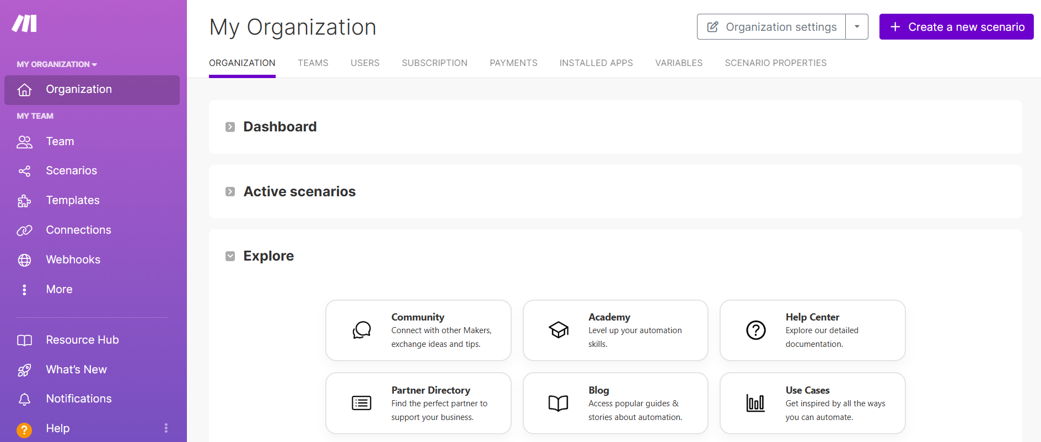

Slide 18
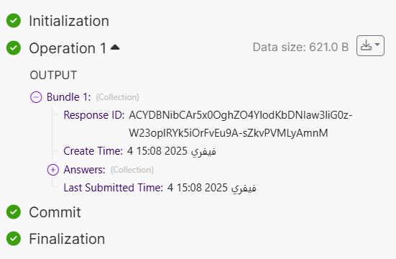
Key:
Response ID
Value: ACYDBNibCAr5x0OghZO4YlodKbDNIaw3liG0z-W23oplRYk5iOrFvEu9A-sZkvPVMLyAmnM

Slide 19
More Details
https://alidaryabak.com/blog/

Slide 20
End of Part 1
Ali Daryabak
ECRM Manager
Marketing Automation Expert

