Slide 1
Make.com
Part 2
Ali Daryabak
Ali Daryabak
ECRM Manager
Marketing Automation Expert

Slide 2
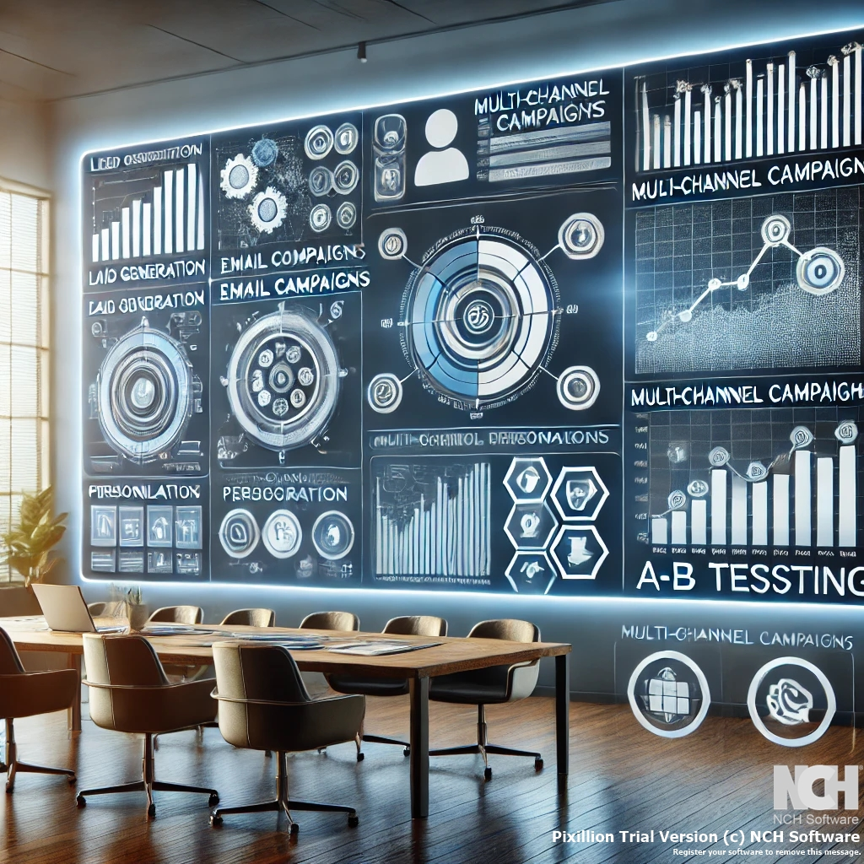
Make.com Router
01
About Router
Ali Daryabak
ECRM Manager
Marketing Automation Expert

Slide 3
Routers
Ali Daryabak
ECRM Manager
Marketing Automation Expert

Slide 5
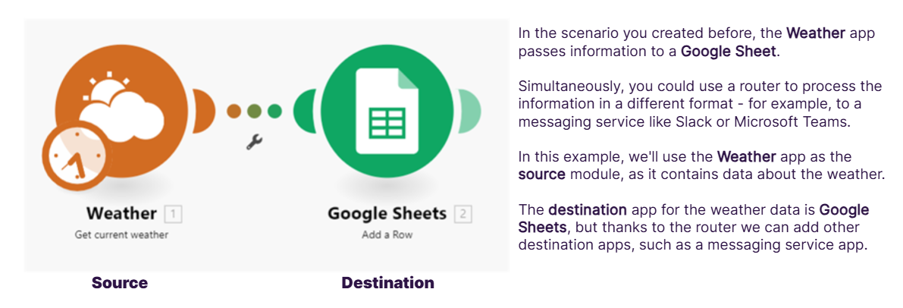
Why Use Routers

Slide 6
Example of Router

Slide 7
Adding Router
Ali Daryabak
ECRM Manager
Marketing Automation Expert

Slide 8
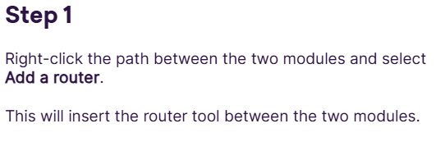
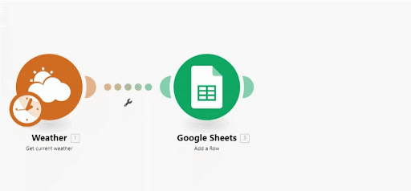

Slide 9
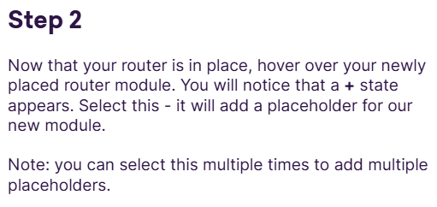
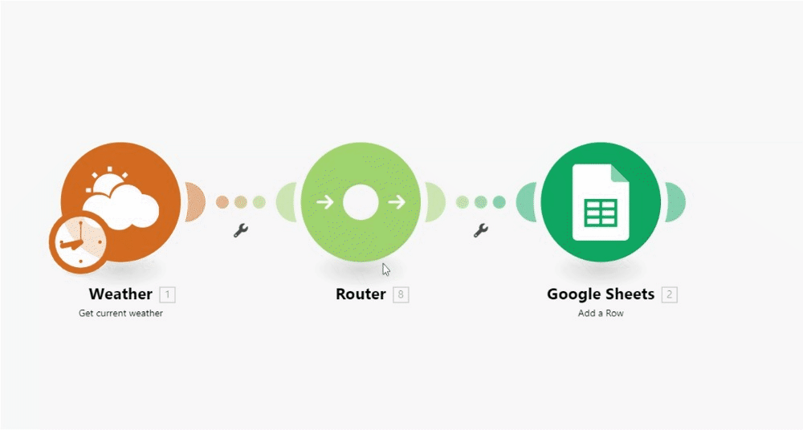

Slide 10
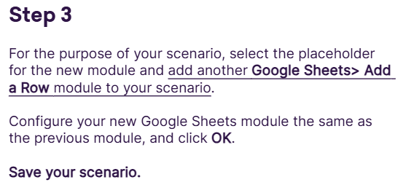
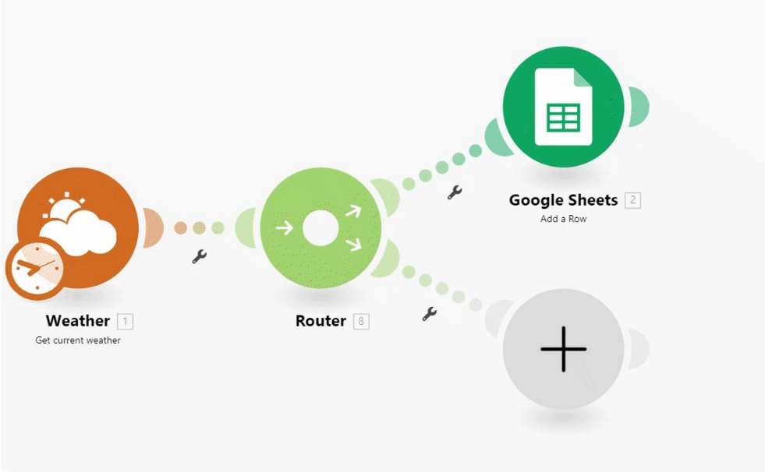

Slide 11
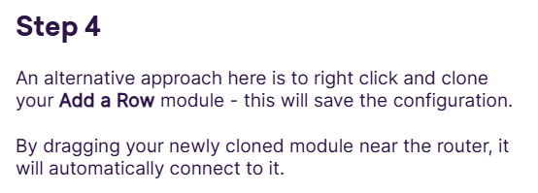
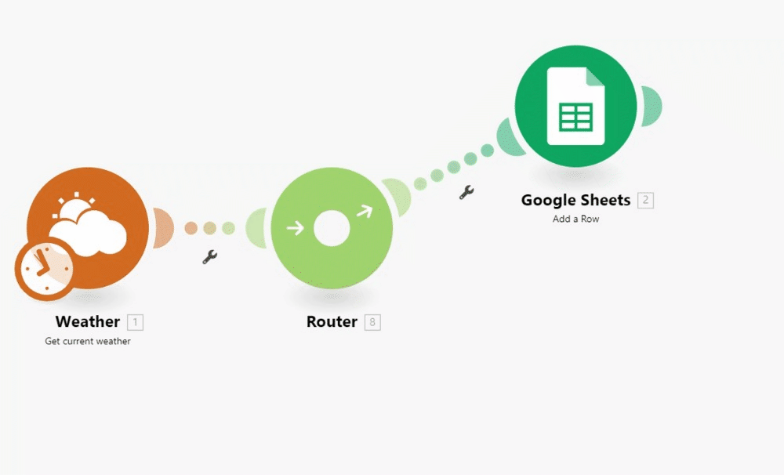

Slide 12
Adding Router
Method 2
Ali Daryabak
ECRM Manager
Marketing Automation Expert

Slide 13
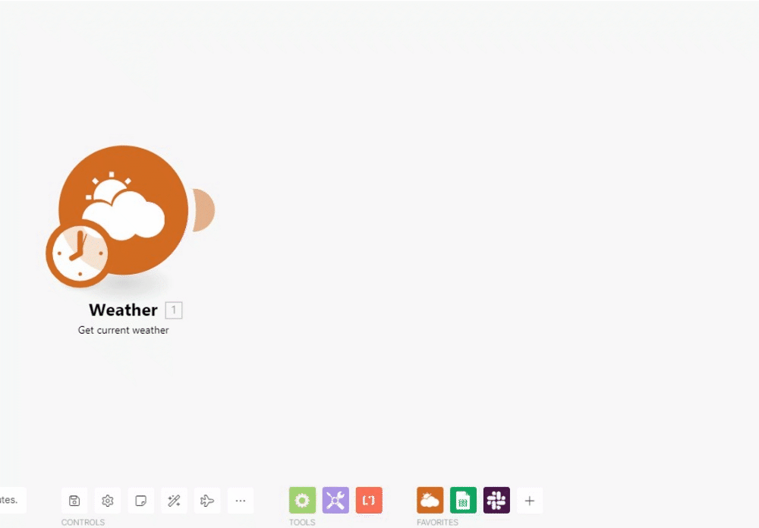

Slide 14
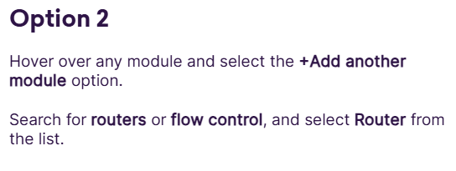
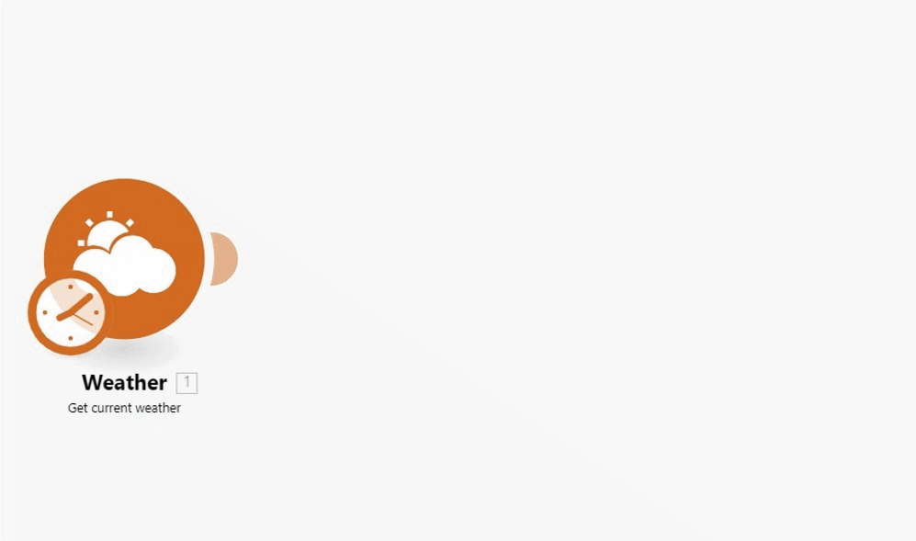

Slide 15
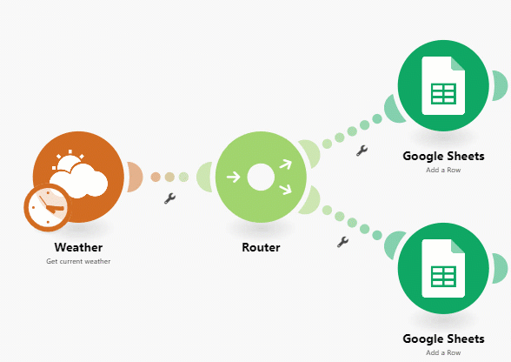
How Data Process?

Slide 16
Example
Ali Daryabak
ECRM Manager
Marketing Automation Expert

Slide 17
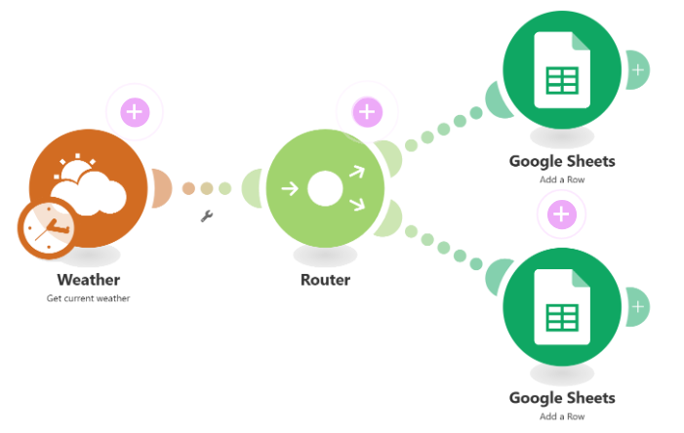

Slide 18
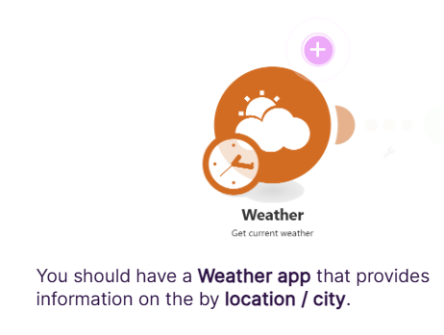

Slide 19
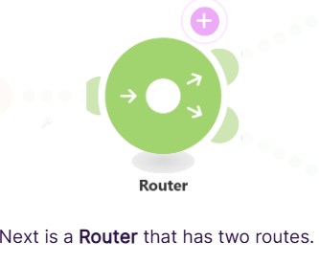

Slide 22
More Details
https://alidaryabak.com/blog/

Slide 23
End of Part 2
Ali Daryabak
ECRM Manager
Marketing Automation Expert

